Slide 1

Tiansheng Liu
Kewen Su
Haozhe Zhang
Fengjun Li
Yinan Chen
Trung Kien Hoang
Xiaohan Li
ISYS3888
Web Platform for Client-Supplier Business Management
—— Supplier part
Group 3 ：DayDream

Slide 2
01
Product overview
1.1 How does it work
1.2 Guideline to start
1.3 Database structure
1.4 Two scenarios
1.5 Demonstration

Slide 3

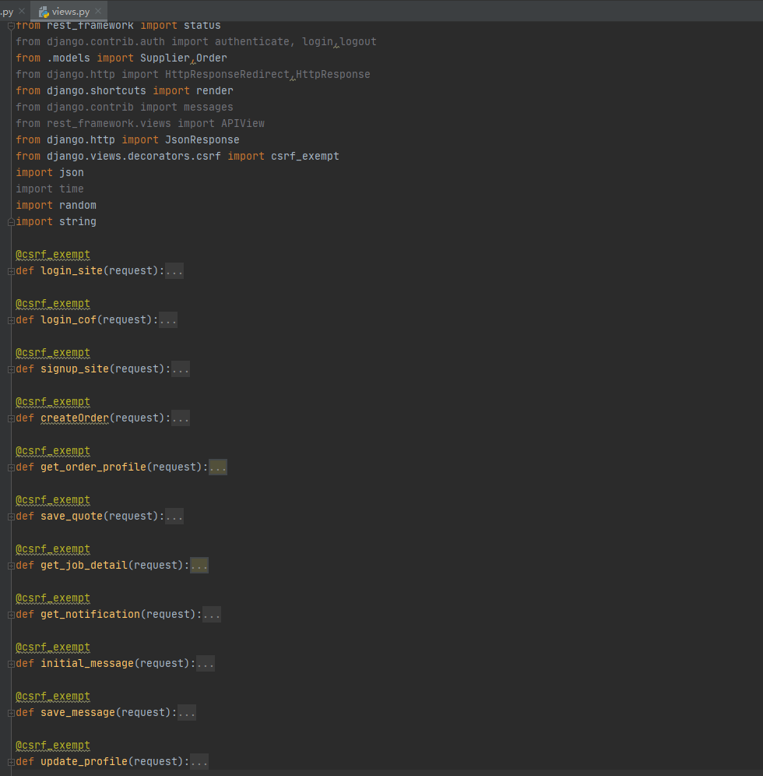
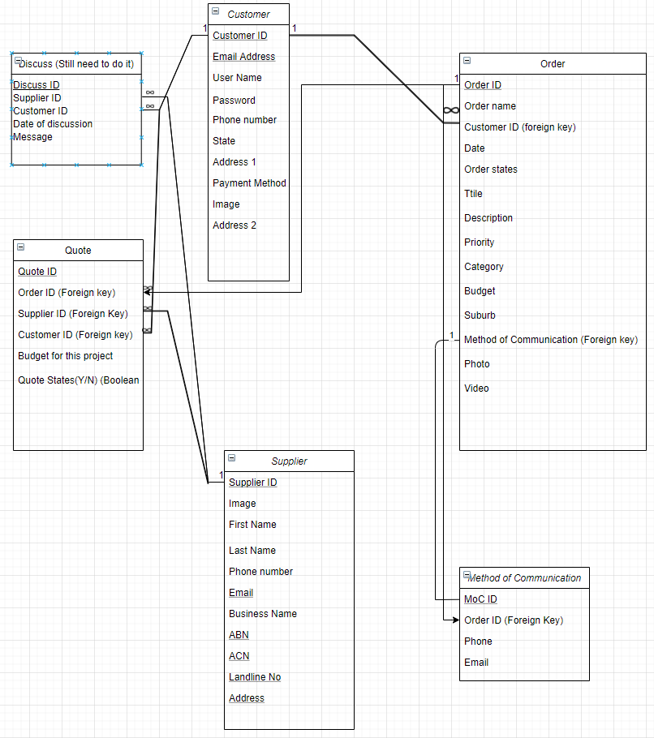
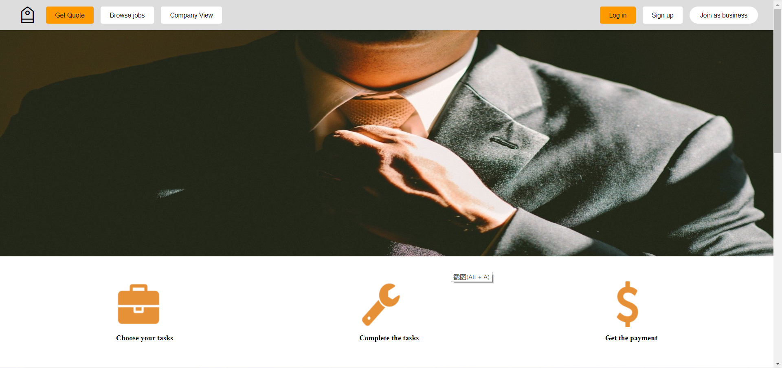
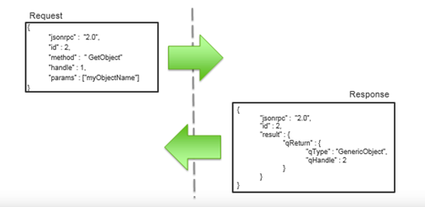
How does it work?
Here is the logic flow for how our website interact with our database,
A 4 - Tier System Architecture
Local host User Interface
JSON API
View.py
Cloud Server Database
Delivery Tier
Package the message as json file
It delivers message to View.py
It delivers message to UI
Logic Tier
- Deployed with AWS
- Provide the functionalities to solve the passed data and interact with the database
- It gets request from JSON API ,and sends back data from database or stores data into database
Presentation Tier
Use AWS server to run the website
It deliverys request to JSON API
It gets data from JSON API
Database Tier
Use AWS cloud service to deploy the database
It gets data from View.py and stores all the data

Slide 4
Guideline to start
Here provide a description of how we can start this application
Front-end website
AWS server
Back-end view.py & database
AWS server
1. Enter “http://3.135.198.81:85/#/” in the URL of the browser to open the web page.
1. Open http://3.135.198.81:8888/026b9e47 which is an admin website of the database in any browser and login with username and password
2. Use terminal ec2-user@ip-172-31-2-121 and cd to the project root which is /www/wwwroot/myproject3888/
3. Use kill -9 `lsof -t -i:8081` to stop current running website and use ./start.sh to start a new one
4. http://3.135.198.81:8081/
# This is the html of the database but it only carries the database since the UI is on the local host

Slide 5
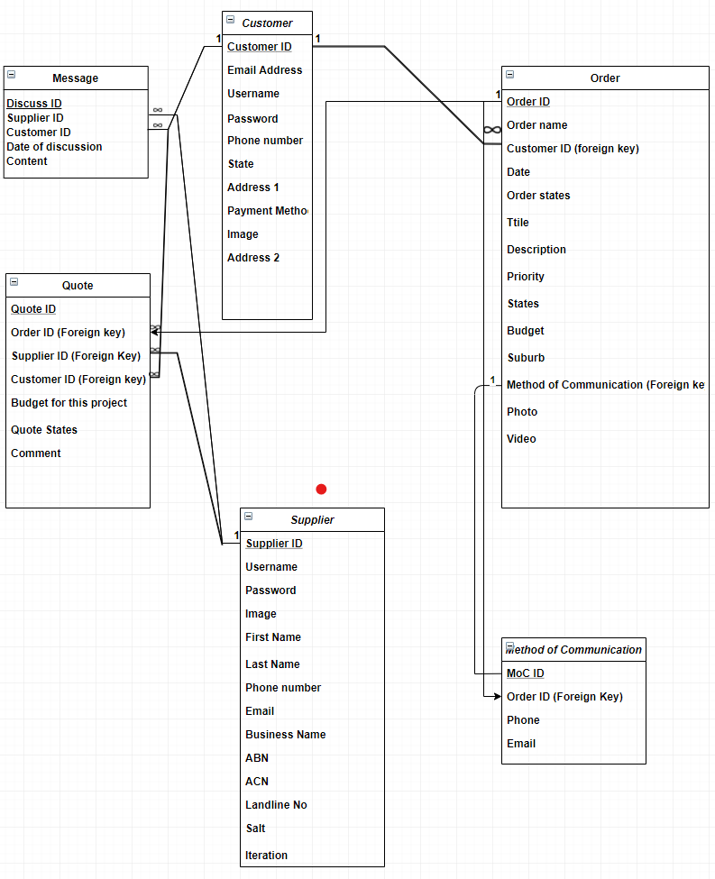
Database structure & Website internal logic
Here use a relationship diagram to describe the database
This is also the Internal logic of the website
A supplier can sign up or log in with their username and password in the supplier homepage.
A supplier can update their profile in the dashboard with the following attributes of supplier.
The salt and iteration are obtained once the supplier signed in successfully.
# They are used to encrypt the password.
A Quote can be generated once a supplier bid on with an order raised by a customer.
# On the other hand, an order can have several quotes since several suppliers can bid on the same order.
The quote states would be changed if a customer accepts or rejects it finally.
The budget in Order would be decided when one of the Quote is accepted, and the other Quotes would be rejected.
A supplier can use my message to have a communication with several customers and the history messages would be stored.
# Vice versa
The order state would be changed to “in progress” once the Quote is accepted and changed to “completed” once the Order is done, and changed to “closed” once the Order is passed.

Slide 6
The scenario of project
Next demonstration will include two different scenarios for supplier
1. New user scenario
Jacky is a new user to the website. He wants to create an account as a part-time job to get some paid. He wants to ensure that his password is secure since he has the experience of hacked.
After signing in, he wants to firstly update his personal information so that the customer can find him easier. Also, he wants to look for an appreciate job by searching and filtering. Then, he find a good job but the budget is a bit below than his expectation. So he wants to send his expected quote and leave a comment to the poster. Finally, he finds his quote has already shown in the job status page and waits for poster’s confirmation.
Password encryption with salt and iteration
Search, Filtering and Pagination
Transfer data to the database
2. Old user scenario
Peter is an old user to the website. He logs in to his account and check his recent jobs in the user home page. And after login successfully, he also wants to check the status of the jobs he accepted before and find which jobs need to be prepared and which jobs are satisfied by users.Finally, he wants to discuss with customer about more details for the current order and also he wants to change the due date with another customer because of some personal issues.
Password encryption with salt and iteration
Search, Filtering and Pagination
Real-time message for supplier
Page access authority

Slide 7
Here we start the demonstration!

Slide 8
Tiansheng Liu
Kewen Su
Haozhe Zhang
Fengjun Li
Yinan Chen
Trung Kien Hoang
Xiaohan Li
Thank You !
Group 3 ：DayDream

